Slide 1

Notes:
Cover Slide

Slide 2


Topic Name
SYNONYMS AND ANTONYMS

Slide 3
INTRODUCTION
Normally english language vocabulary have different meanings at different sentences.
But all the vocabulary can be understood by using root words.
English language have many root words.
When we know the meaning of the root words we can know the meaning of the vocabulary.
Root word is a word that can form the basis of a new word.

Slide 4
Root words
Some of the root words are:
Ambi, amphi – on both sides , around.
Example – ambidextrous – able to use both hands equally.
ambiguous – having more than one meaning.
Ami – love.
Example – amiable – friendly and pleasant.
amity – friendly and peaceful relations.
Ante – before or in front
Example – antecede – to come before something in time.
antemeridian – before noon.

Slide 5
Root words
Anti – against or opposite of
Example – antibody – a substance that destroys the micro organism.
antiseptic – preventing infection.
Astro , astir – stars, outer space
Example – astronaut – a person travelling through stars.
astronomer – someone who studies the stars.
Avi – bird
Example – aviary – a large enclosure for birds.

Slide 6
Root words
Auto – self , same, one.
Example – automatic – moving by itself.
autograph – a person's own signature.
Capt, ceive – take or hold
Example – intercept – to stop or interrupt.
perceive – to take notice of something.
Cogn – know
Example – cognition – the process of acquiring knowledge.
incognito – disguised so no one knows.

Slide 7
Root words
Cred – believe.
Example – credence – believe that something is true.
credulous - believing things too easily.
Dys – abnormal or bad.
Example – dyspecia – abnormal digestion.
dystopia – an imaginary place of total misery.
Ep – on ,over, among ,upon
Example – epidemic – the rapid spread of something negative.
epicentre – centre of the earthquake.

Slide 8
Root words
Haem – blood
Example – haemoglobin – red blood particle.
haemorrhage – clotting of the blood.
Idio – peculiar, personal
Example – idiomatic – peculiar to a particular language.
idiot – someone who is distinctly foolish or stupid.
Viv – live or life
Example – revival – act of bringing back to life.
vital – pertaining to live.

Slide 9
Root words
Arbor – tree
Example – arboreal – living in trees
arborist – a tree surgeon
Norm – typical
Example – abnormal – deviating from normal or usal
normality – condition of being expected
Phobia – fear
Example – hydrophobia – extreme fear of water
claustrophobia – extreme fear of confined places

Slide 10
Root words
Acri – bitter
Example – acrid – unpleasantly bitter
acrimony – ill feeling
Archy – rule
Example – hierarchy – a ranking system or procedure to authority
monarchy – form of government with a monarch at the head
Pan – all
Example – pandemic – prevalent over a whole country
panacea – a solution for all difficulties or diseases

Slide 11
Root words
Thei – god
Example – atheist – a person who disbelieves in the existence of god
pantheist – worship of all gods of different religion
Cert – sure
Example – certify – confirm in a formal statement
certainly – used to emphasize the speakers belief is true
Somni or hypno – sleep
Example – insomnia – inability to sleep
somniloquy – talking aloud in sleep
hypnosis – hypnotic state
hypnotism – study or practise of hypnotisis

Slide 12
Root words
Soli – single
Example – solitude – a state of being alone
Omni – all
Example – omnivore – animal that eat both plants and animals
omnipresent – present everywhere
Vore – to eat greedily
Example – herbivore – animals that feed on plants
omnivore – animals feeds on both plants and animals

Slide 13
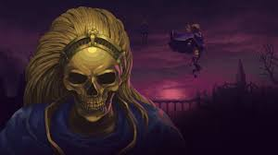
Question: 01
Select the word or phrase which best expresses the meaning of the given word:
BLASPHEMOUS
Convict
Gather
Impious
Pious
Answer: C

Slide 14
Explanation: 01
The meaning of the word is it is irreverent and sacrilegious against god.
This relates exactly to impious

Slide 15
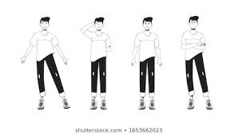
Question: 02
Select the word or phrase which best expresses the meaning of the given word:
BAFFLE
Regard
Confound
Perplex
Scorn
Answer: C

Slide 16
Explanation: 02
BAFFLE means to bewilder by the event happened.
Perplex means exactly the same.
Scorn means to hate something and to avoid it and hate it completely.
Confound means to defeat or to prove or to cause confusion and surprise.
Regard means to consider.

Slide 17
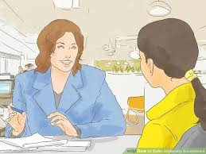
Question: 03
Select the word or phrase which best expresses the meaning of the given word:
DEFER
Indifferent
Defy
Differ
Postpone
Answer: D

Slide 18
Explanation: 03
Indifferent : having no particular interest or sympathy, unconcerned.
Defy : openly resist or refuse to obey.
Differ : be unlike or dissimilar.
Postpone : cause or arrange for (something) to take place at a time later than that first scheduled.
Defer : put off (an action or event) to a later time; postpone

Slide 19
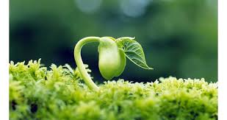
Question: 04
Select the word or phrase which best expresses the meaning of the given word:
GERMINATE
Decay
Breed
Produce
Sprout
Answer: B

Slide 20
Explanation: 04
Decay : rot or decompose through the action of bacteria and fungi.
Produce : make or manufacture from components or raw materials.
Sprout : put out shoots.
Breed : mate and then produce offspring.
Germinate : begin to grow and put out shoots after a period of dormancy.

Slide 21
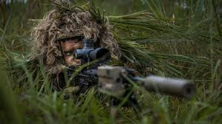
Question: 05
Select the word or phrase which best expresses the meaning of the given word:
CAMOUFLAGE
Aggressive
Deception
Vigilant
Honour
Answer: A

Slide 22
Explanation: 05
Camouflage refers to to hide or to deceive by the presence where the soldiers do it in the borders
Vigilant refers to keeping careful watch over something

Slide 23
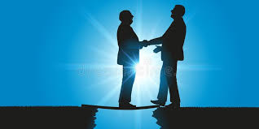
Question: 06
Select the word which is same in the meaning of the given word:
CREDULOUS
Joyous
Interpret
Trusting
Interest
Answer: C

Slide 24
Explanation: 06
Credulous refers to trust people readily

Slide 25
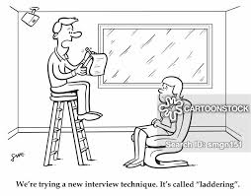
Question: 07
Select the word which is same in the meaning of the given word:
DAUNT
Clever
Frighten
Vague
Lapse
Answer: B

Slide 26
Explanation: 07
Daunt is trying to make someone fearful.

Slide 27
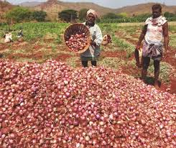
Question: 08
Select the word which is same in the meaning of the given word:
GLUT
A. Kindness
B. Overflow
C. Restrain
D. Bright
Answer: B

Slide 28
Explanation: 08
Abundant supply of something refers to glut

Slide 29

Question: 09
Select the word which is OPPOSITE in the meaning of the given word:
ABSTAIN
A. Hoard
B. Tolerate
C. Forbear
D. Begin
Answer: D

Slide 30
Explanation: 09
Hoard : a stock or store of money or valued objects, typically one that is secret or carefully guarded. Tolerate : bear, forbear, forebear, abide.
Forbear : bear, forbear, forebear, abide.
Begin : commence, induct.
Abstain : restrain oneself from doing or enjoying something. Antonym of Abstain is Begin.

Slide 31
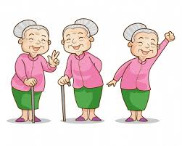
Question: 10
Select the word which is OPPOSITE in the meaning of the given word:
BENIGN
Malevolent
Soft
Friendly
Unwise
Answer: A

Slide 32
Explanation: 10
Soft : easy to mould, cut, compress, or fold, not hard or firm to the touch, soft, bland, malleable, moderate, tender, flaccid
Friendly : kind and pleasant.
Unwise : (of a person or action) not wise or sensible, foolish.
Malevolent : having or showing a wish to do evil to others.
Benign : gentle and kind. Appropriate antonym of Benign is Malevolent.

Slide 33
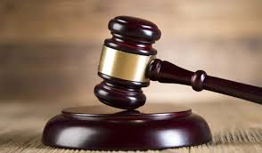
Question: 11
Select the word which is OPPOSITE in the meaning of the given word:
ACQUIT
A. Deprive
B. Retreat
C. Convict
D. Conceal
Answer: C

Slide 34
Explanation: 11
Retreat : digress, recoil, shrink back, retrograde, fall back.
Conceal : hide, secrete, conceal, stash, wrap.
Deprive : debar, shear, bereave, mulct, denude.
Convict : declare (someone) to be guilty of a criminal offense by the verdict of a jury or the decision of a judge in a court of law.
Acquit : liberate, rid, set free, release, exempt. Antonyms of Acquit is Convict.

Slide 35
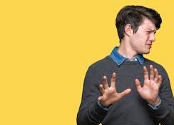
Question: 12
Select the word which is OPPOSITE in the meaning of the given word:
AVERSION
A. Avoidable
B. Awareness
C. Hatred
D. Liking
Answer: B

Slide 36
Explanation: 12
Avoidable: Able to be avoided or prevented.
Awareness: Knowledge or perception of a situation or fact.
Hatred: Intense dislike; hate.
Liking: A feeling of regard or fondness.
AVERSION: A strong dislike or disinclination. Antonym of AVERSION is Liking

Slide 37
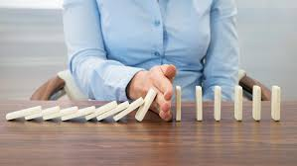
Question: 13
Select the word which is OPPOSITE in the meaning of the given word:
MITIGATE
A. Abate
B. Aggravate
C. Allay
D. Alleviate
Answer: B

Slide 38
Explanation: 13
Abate: (Of something unpleasant or severe) become less intense or widespread.
Aggravate: Make (a problem, injury, or offence) worse or more serious
Allay: Diminish or put at rest (fear, suspicion, or worry).
Alleviate: Make (suffering, deficiency, or a problem) less severe.
MITIGATE : Make (something bad) less severe, serious, or painful. Antonym of MITIGATE is Aggravate

Slide 39
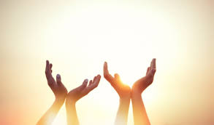
Question: 14
Select the option that is most nearly OPPOSITE in meaning to the given word :
BENEDICTION
Antidote
Intonation
Endowment
Anathema
Answer: D

Slide 40
Explanation: 14
Benediction refers to a prayer asking for divine blessing.
Antidote refers to something that counteracts an unpleasant feeling or situation.
Intonation refers to the rise and fall of the voice in speaking.
Endowment refers to a quality or ability possessed or inherited by someone.
Anathema refers to a strong curse.

Slide 41
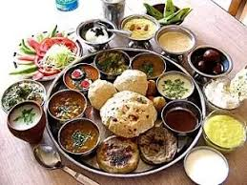
Question: 15
Select the option that is most nearly OPPOSITE in meaning to the given word:
SUMPTUOUS
Open
Frequent
Restrained
Partial
Answer: C

Slide 42
Explanation: 15
Sumptuous refers to splendid and expensive-looking.

Slide 43
THANK YOU

